Slide 1

Database Manager system
ADVANCE SOFTWARE PROJECT

Slide 2
Database Manager system
TEAM MEMBERS :
Sana Eid
Dina Alawneh
Rahaf Shami
Yara Abu Odeh

Slide 3
Our project
This system is Database manager System(web Site app )
This system will access make connection on DB and making access to it’s tables
change the database connection at runtime .
import(XML , CSV , JSON , SQL ) file and insert file data in DB table
export data and schema for (csv , xml )file
Making queries on DB to (create, update , delete ) →(CRUD) functions
Basically,DBM system face the problem of viewing , inserting , modifying data in DB tables , in other words , it's for managing and controlling our DB in an efficient way .

Slide 4
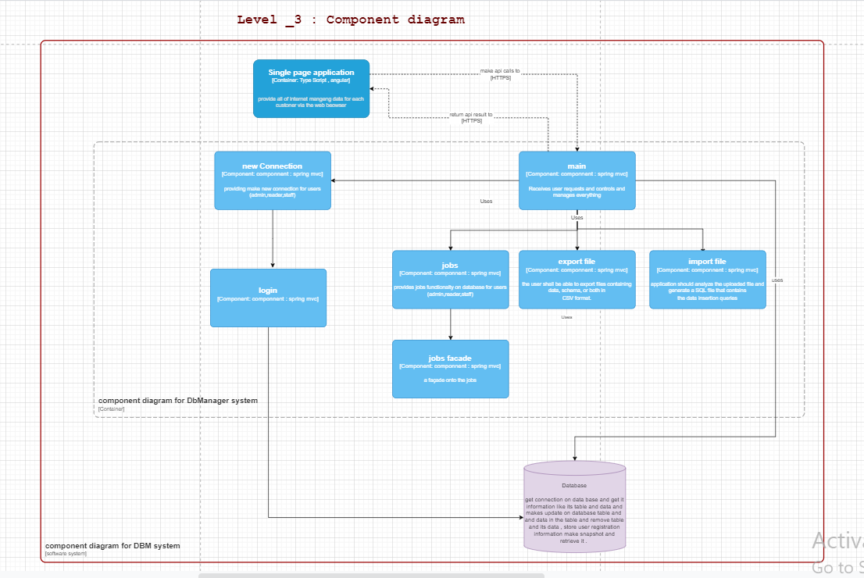
Level _3 : Component diagram

Slide 5
DAIAGRAMS
https://app.diagrams.net/#G1LrbtxNh4oQicZkLkRLbz5QiGtoDhzGGN

Slide 6
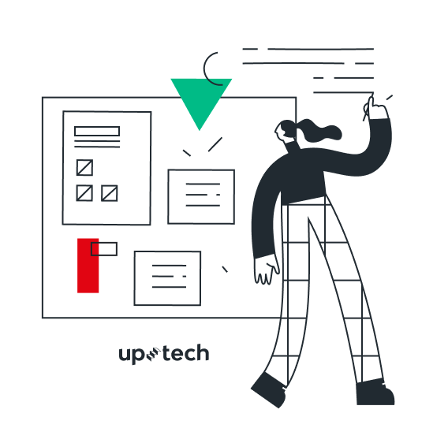
How did we achieve
THE FUNCTIONAL REQUIREMENTs

Slide 7
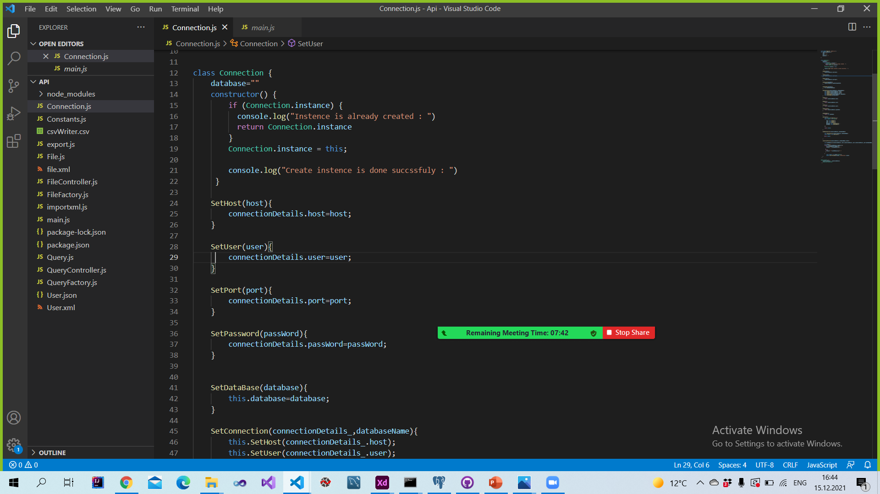
Connection

Slide 8
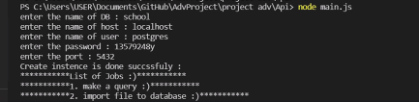
The output:

Slide 9
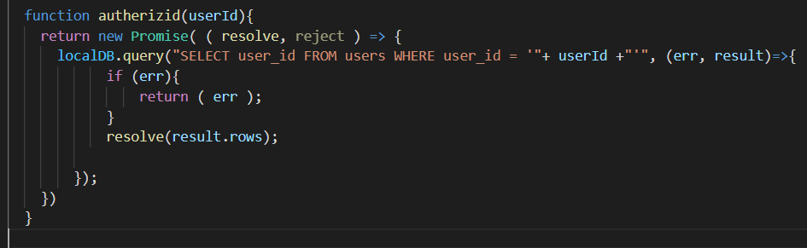
Authorize Id

Slide 10
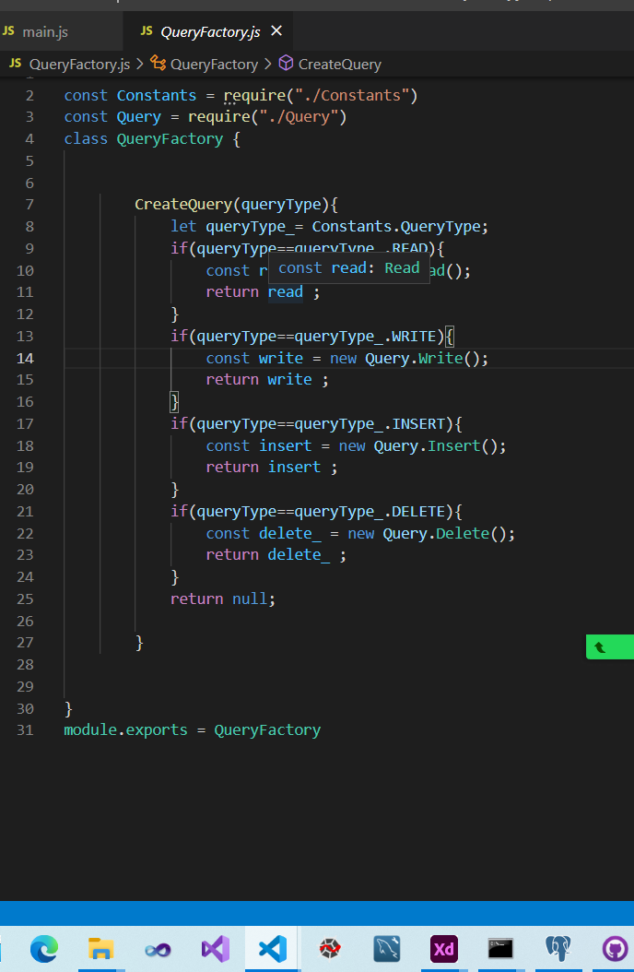
Class Query

Slide 11
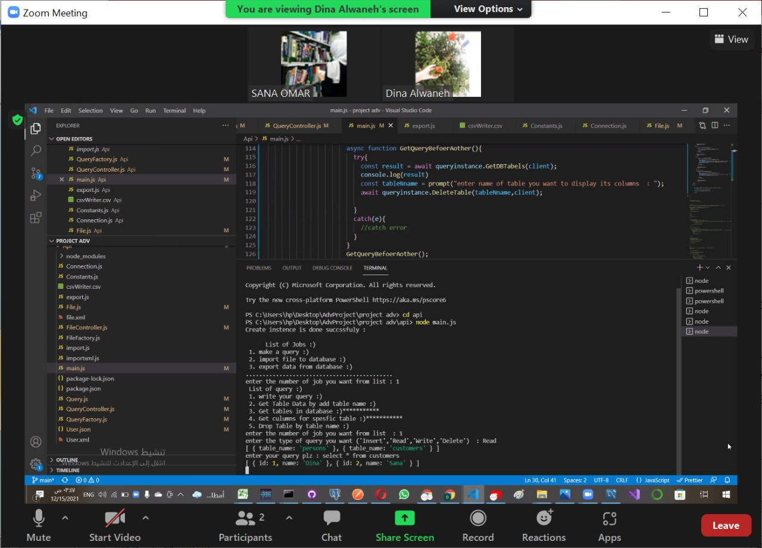
1)Out put write query

Slide 12
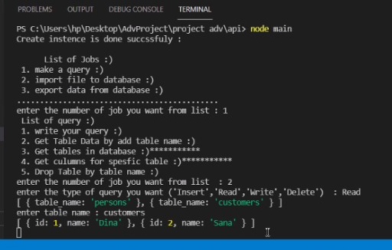
2)The out put table name

Slide 13
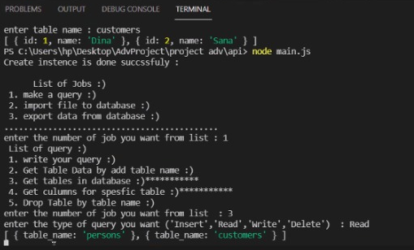
3)The out put table in data base

Slide 14
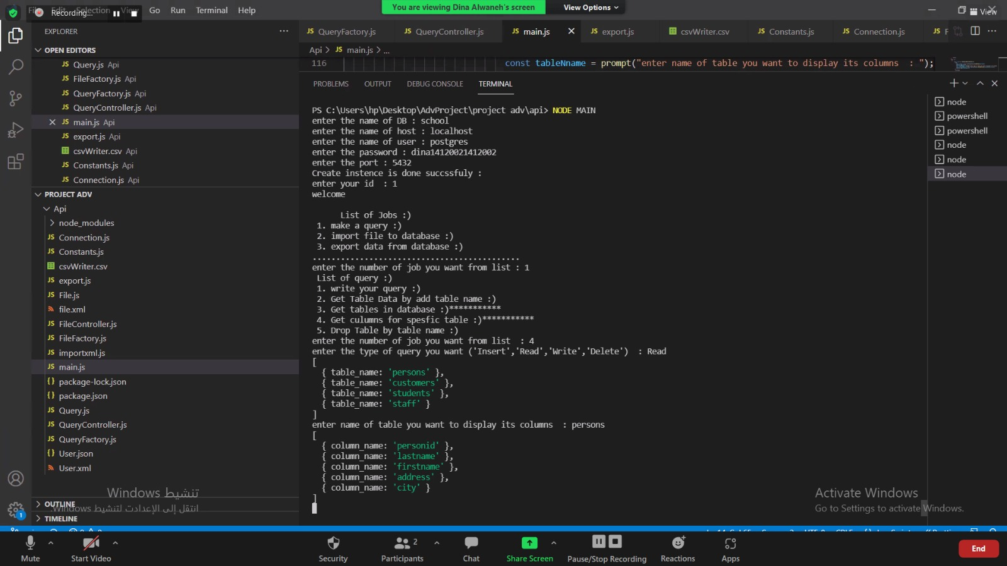
4)Out put columns of specific table

Slide 15
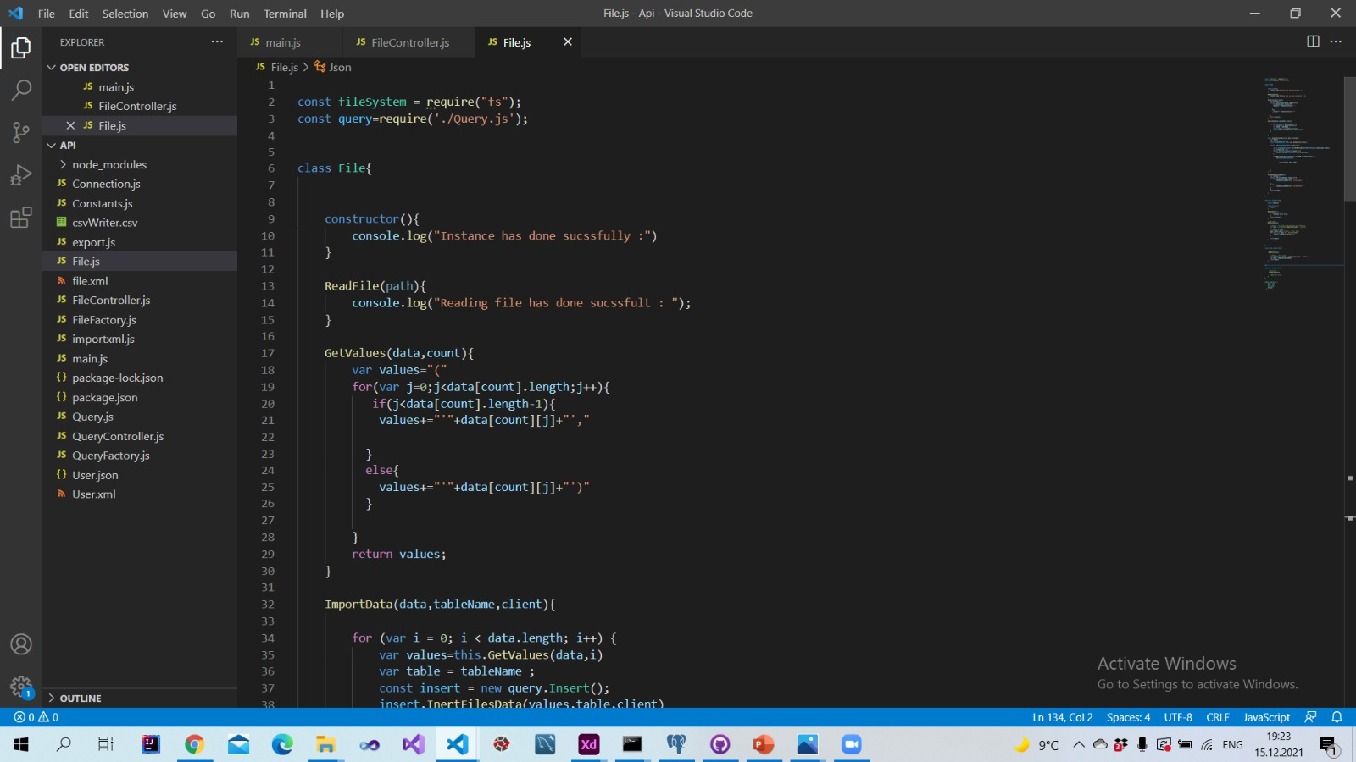
Class file

Slide 16
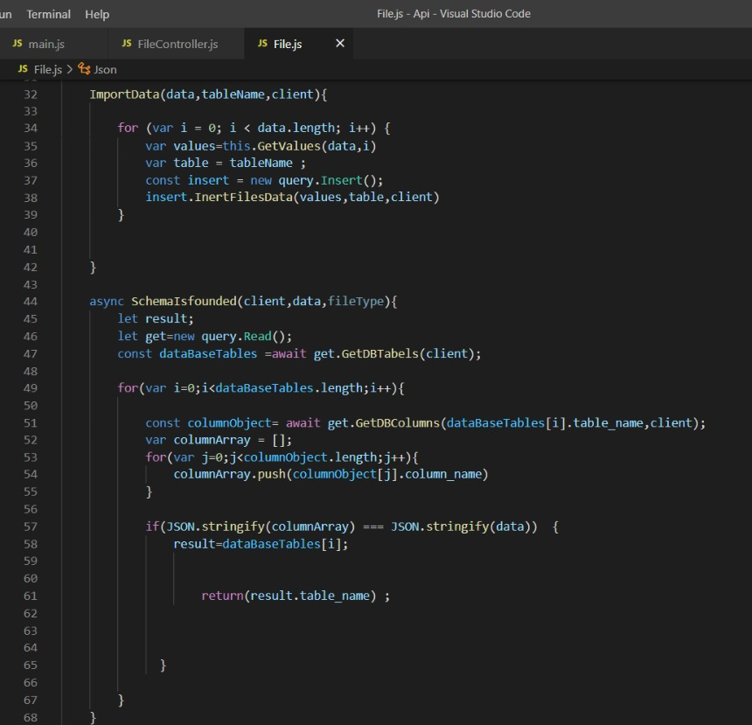

Slide 17
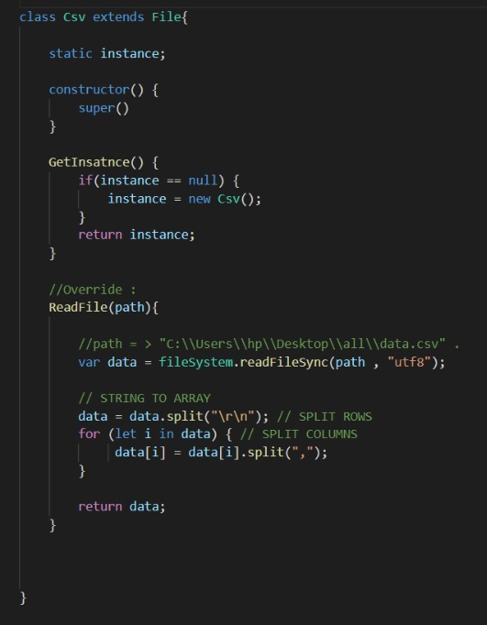
CSV class

Slide 18
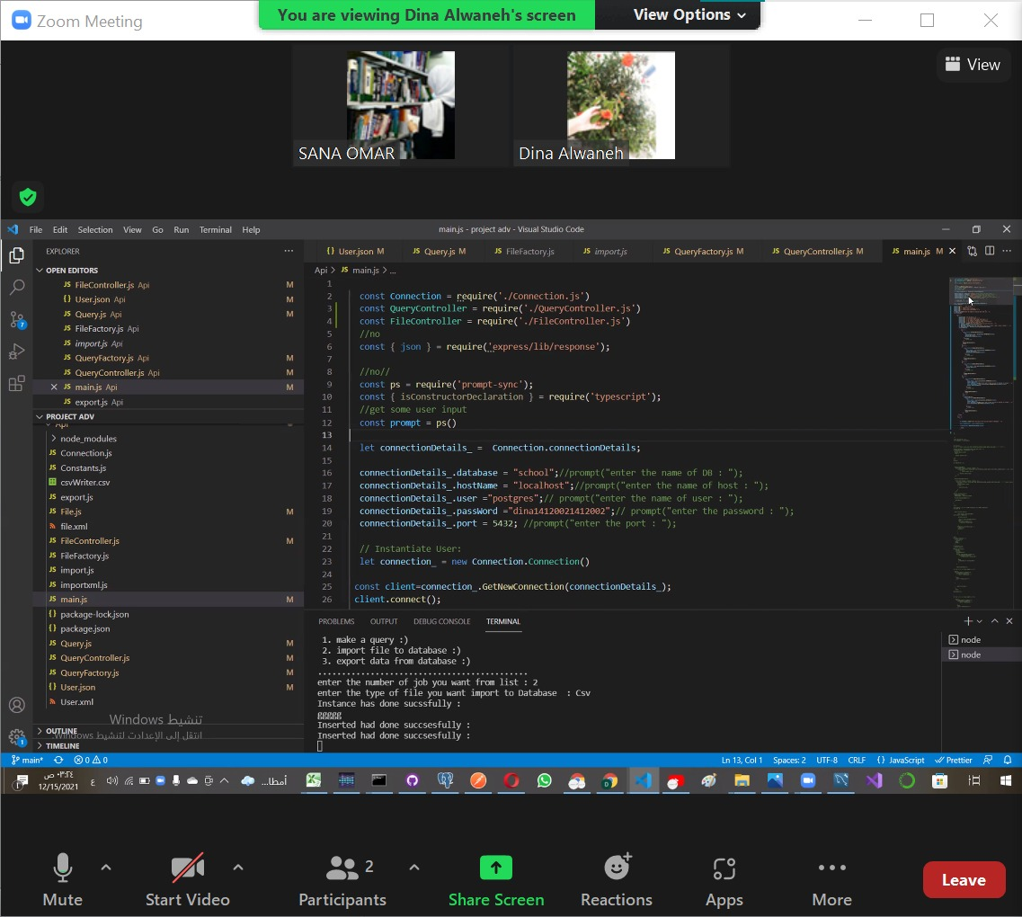
The output:

Slide 19
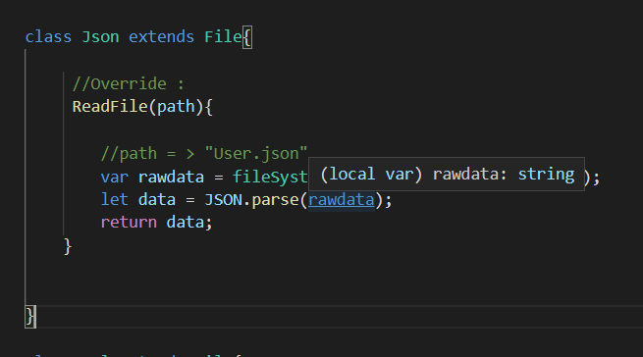
class json

Slide 20
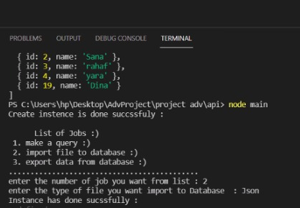
Out put

Slide 21
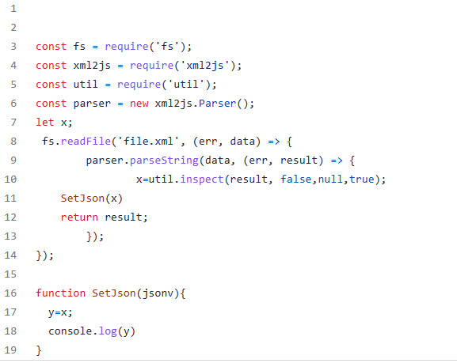
Import XML

Slide 22
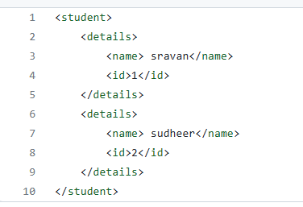
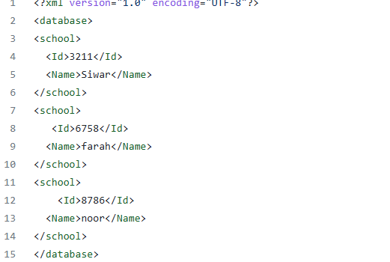
The XML Files..

Slide 23
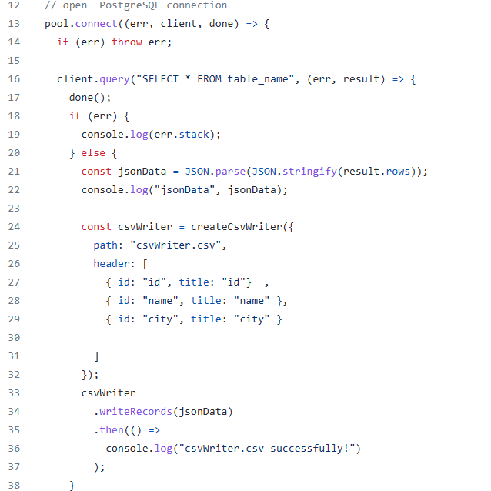
Export the CSV file

Slide 24
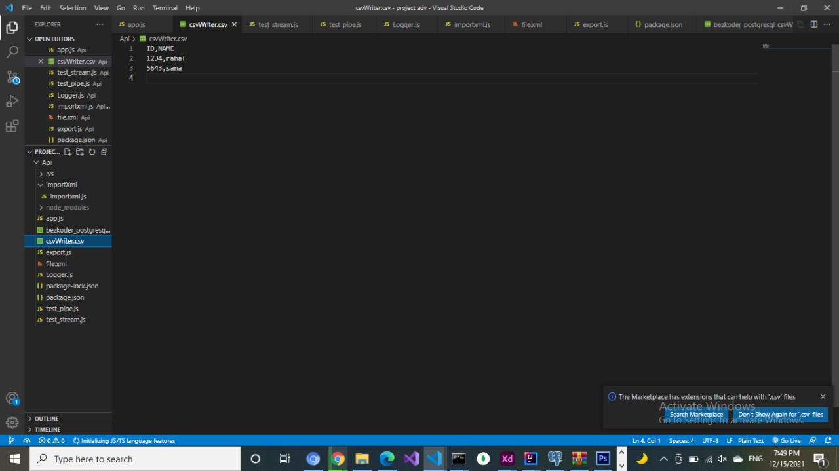
The output:

Slide 25
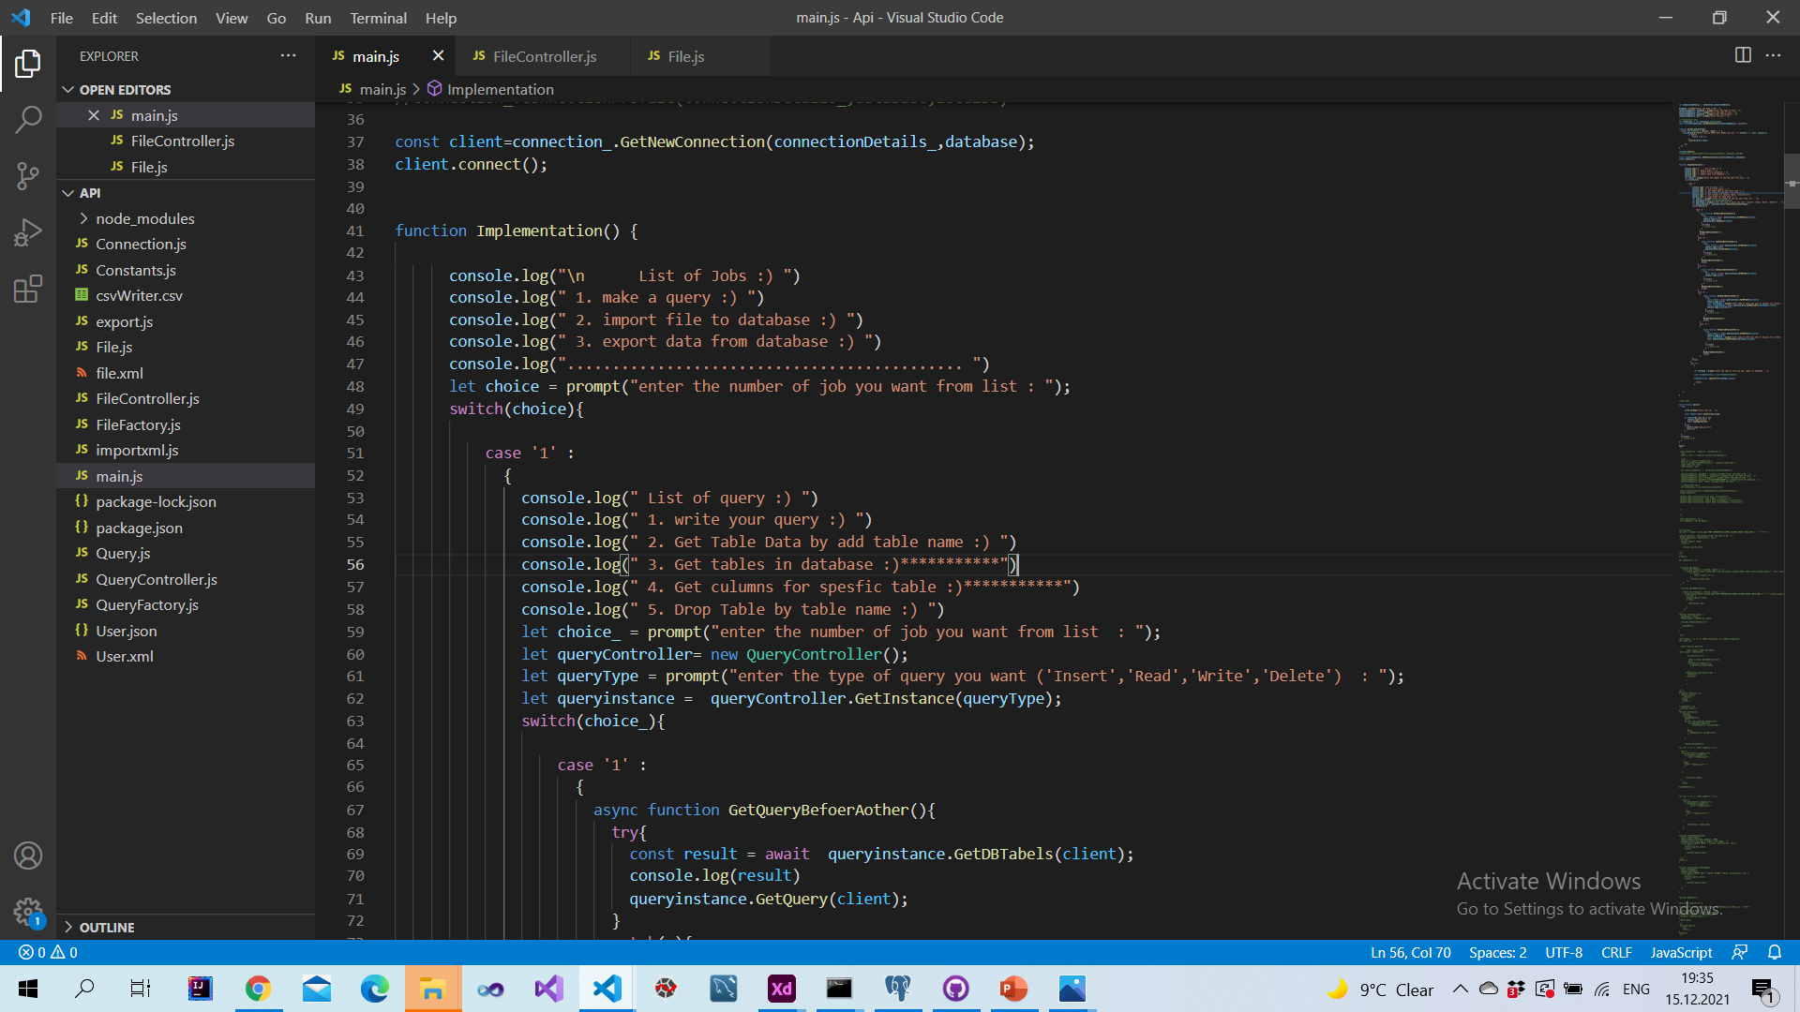
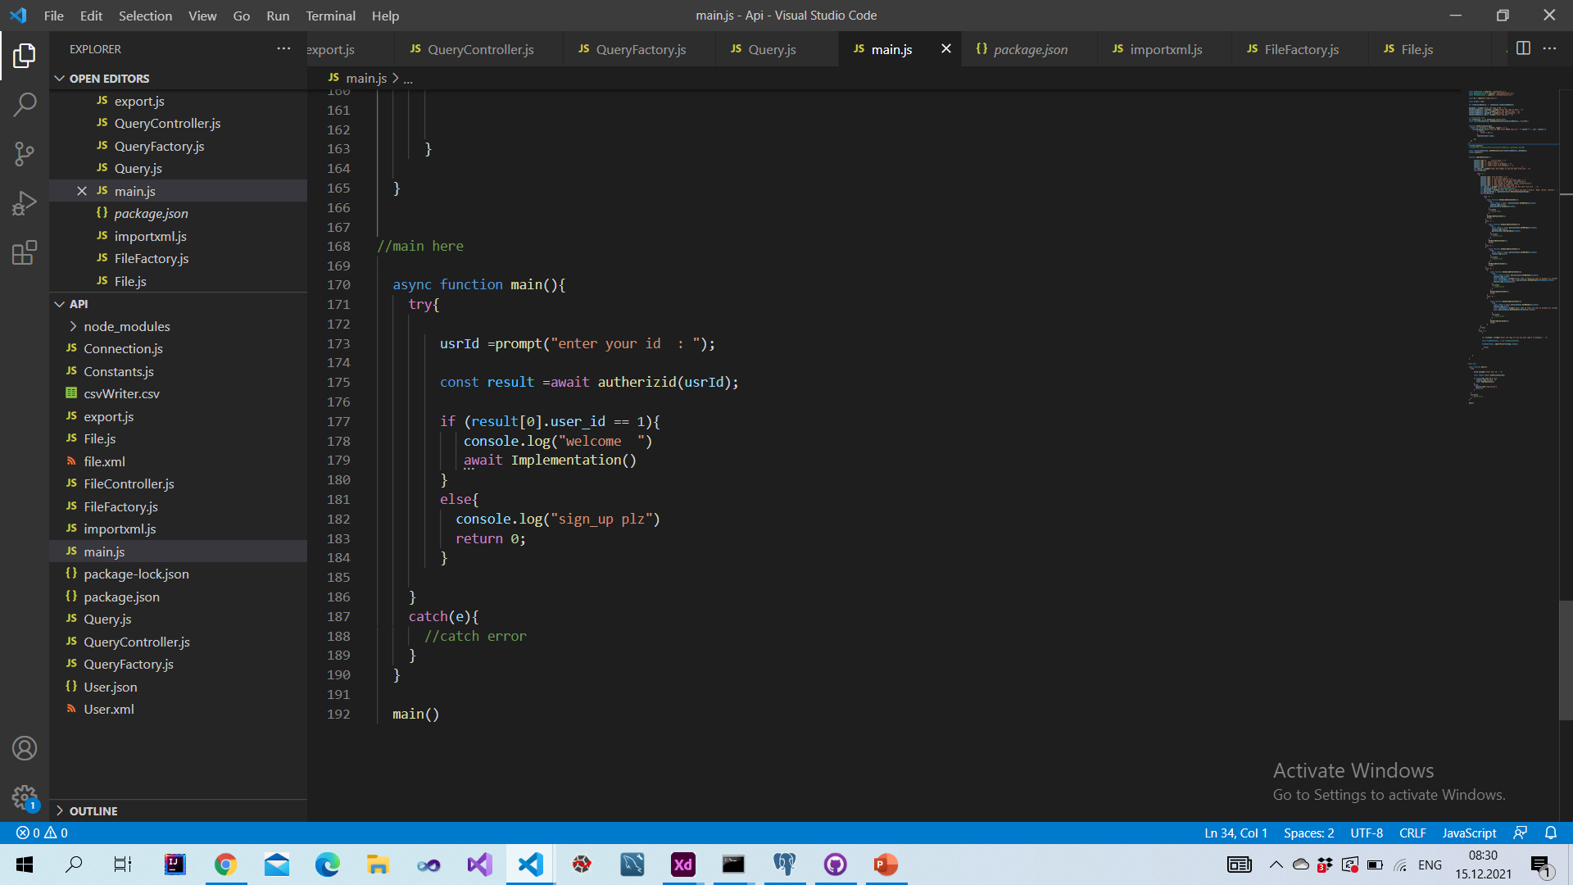
main

Slide 26
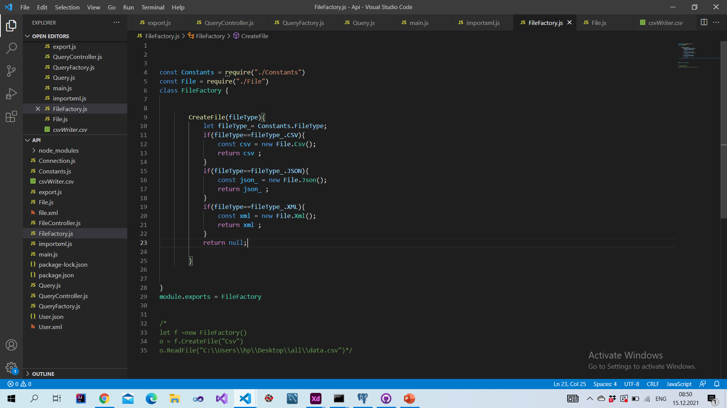
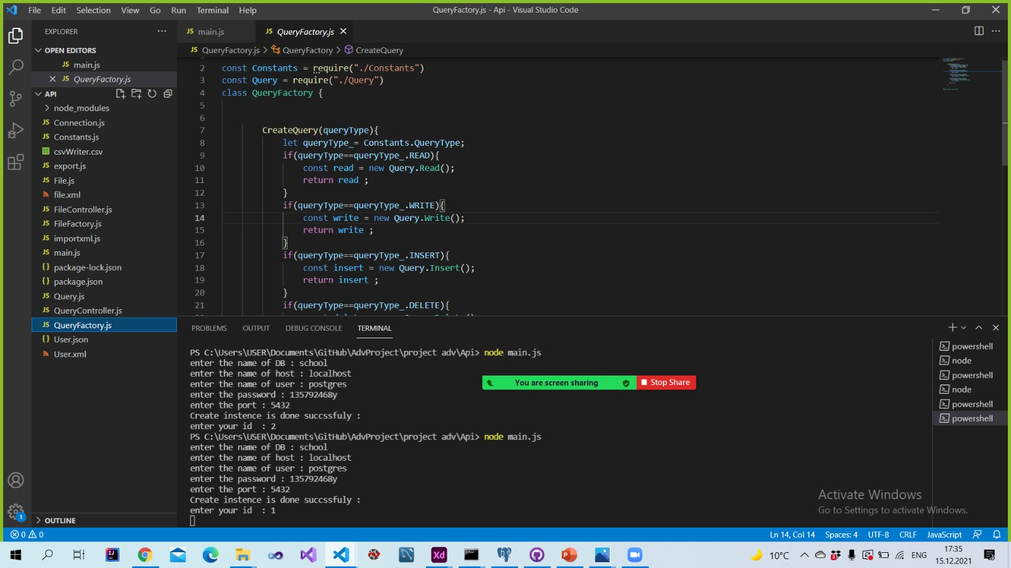
Factory Design Pattern

Slide 27
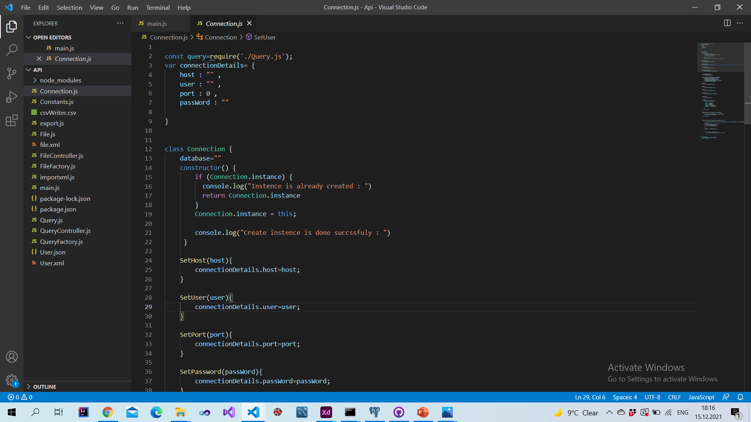
Singleton Design pattern

Slide 28

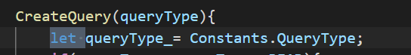
Clean code and Code conversion
Ex.Naming :
for the functions and variables we put static way cap . Letter for each word in the first like
And the variables : capital letter for the second word

Slide 29
System scalability
We use the solid principles
Make the connection non static
We use factory design pattern in queries job and files
And use singleton design pattern in connection
Buit With ♥

